Slide 1

PRESENTATION ON:
K NEAREST NEIGHBOUR REGRESSION (KNN)

Slide 2
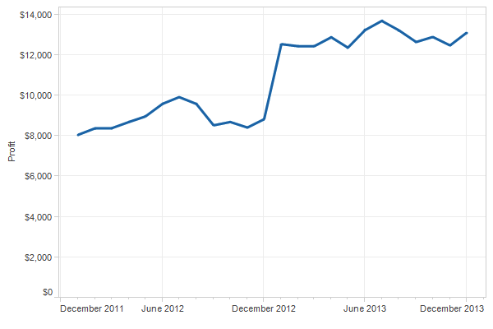
REGRESSION:
Regression is a type of supervised learning in machine learning where the goal is to predict a continuous target variable based on one or more input features. It is used to model the relationship between a dependent variable (the target) and one or more independent variables (the inputs).

Slide 3
There are several types of regression in machine learning, including:
Linear regression
Polynomial regression
3.Multiple linear regression
4.Logistic regression
5.KNN regression.
6.Decision tree regression
7Random forest regression
8.Support Vector Regression (SVR
9.Neural network regression

Slide 4
ABOUT KNN REGRESSION :
K-Nearest Neighbor is one of the simplest Machine Learning algorithms based on Supervised Learning technique.
K-NN algorithm assumes the similarity between the new data and available cases and put the new data into the category that is most similar to the available categories. This means when new data appears then it can be easily classified into a well suite category by using K- NN algorithm.
K-NN is a non-parametric algorithm which means it does not make any assumption on underlying data.
It is also called a lazy learner algorithm because it does not learn from the training set immediately instead it stores the dataset and at the time of classification, it performs an action on the dataset.
K is an hyperparameter the larger the value of k the more accurate the results will be and if the K is smaller then the results are most likely to the noise data.

Slide 5
WORKING OF KNN REGRESSION STEPS:
Step-1 : Choose a value for "k" (the number of nearest neighbors to consider).
Step-2 : Calculate the distance between the data point to be predicted and all other data points in the dataset.
Step-3 : Select the "k" data points that are closest (nearest) to the data point to be predicted.
Step-4 : predict the value of the data point based on the average value of the "k" nearest neighbors.
Step-5 : Assign the new data points to that category for which the number of the neighbor is maximum.
Step-6 : Our model is ready.

Slide 6
DISTANCE METRICS USED IN KNN REGRESSION :
The Euclidean distance :
Formula :
d(x, y) = √Σ(xi - yi)^2
where,
“xi” and “yi” = the components of the points “x” and “y”.
Σ = the sum over all dimensions.
The Manhattan distance :
Formula :
d(x, y) = Σ|xi - yi|
where,
“xi” and “yi” = the components of the points “x” and “y”.
Σ = the sum over all dimensions.
Minkowski distance :
Formula :
d(x, y) = (Σ|xi - yi|^p)^(1/p)
where,
“xi” and “yi” = the components of the points “x” and “y”.
Σ = the sum over all dimensions.
When "p = 2", the Minkowski distance becomes the Euclidean distance, and when "p = 1", it becomes the Manhattan distance.

Slide 7
PARAMETERS IN KNN :
KNN regression is an non-parametric model it doesn’t contain any parameters.
WHY KNN IS CONSIDERED AS NON-PARAMETRIC MODEL?
Because it does not make any assumptions about the underlying distribution of the data instead it simply stores all the available training samples and use them to make predictions.
Since KNN does not fit a specific model to the data , it is considered to be non-parametric and is widely used when the underlying distribution of the data is unknown or complicated.

Slide 8
HYPER-PARAMETERS :
In KNN regression, the main hyperparameter is "K", the number of nearest neighbors used to make the prediction for a given data point.
The choice of "K" has a direct impact on the performance of the KNN regression model.
HOW TO SELECT THE “K” VALUE IN KNN?
There is no definite method to determine the optimal value of K in KNN, but there are several commonly used techniques to select an appropriate value of K:
1. Cross-Validation Method.
2. Elbow Method.
3. Grid Search.

Slide 9
EVALUATION METRICS USED :
Mean Absolute Error (MAE):
Formula :
MAE = (1/n) * Σ|predicted_value - actual_value|
where,
n = no of samples.
Σ = the sum over all samples.
2.Mean Absolute Percentage Error (MAPE):
Formula :
MAPE = (100/n) * Σ(|(actual_value - predicted_value) / actual_value|)
where,
n = the number of samples in the dataset
Σ = the sum over all samples.
3.Mean Squared Error (MSE):
Formula :
MSE = (1/n) * Σ(predicted_value - actual_value)^2
where,
n = no of samples.
Σ = the sum over all samples.

Slide 10
4.Root Mean Squared Error (RMSE):
Formula :
RMSE = √(MSE) = √((1/n) * Σ(predicted_value - actual_value)^2)
where,
n = number of samples in the dataset
Σ = the sum over all samples.
5.R-squared (R^2):
Formula :
R^2 = 1 - (Σ(actual_value - predicted_value)^2 / Σ(actual_value - mean_of_actual_values)^2)
where,
Σ = the sum over all samples.
mean_of_actual_values = the average of the actual values.
6.Adjusted R-squared:
Formula :
Adjusted R^2 = 1 - [(1 - R^2) * (n - 1) / (n - k - 1)]
where,
n = the number of samples.
k = the number of independent variables in the model.
R^2 = the ordinary R-squared value.

Slide 11
ADVANTAGES :
Simple and easy to implement
No assumptions about distribution of data
Flexible
Robust to Outliers
Can handle high dimensional data
DISADVANTAGES :
Computationally intensive
Curse of dimensionality
Sensitive to irrelevant features
Quality of results depends on the choice of k
Not suitable for continuous outputs

Slide 12
USED CASES IN REAL LIFE :
KNN regression can be used in a variety of real-time applications, including:
Stock market prediction
Sales forecasting
Customer segmentation
Quality control
Fraud detection

Slide 13


